Slide 1
WorkSource
Qtrac® Super User Training
Presenter: Eldar Erlich

Slide 2
Agenda
Super User Tools:
Manager Station / Live Analytics
Station Management
Reporting Capabilities
Live System Demonstration
Support Plan

Slide 3
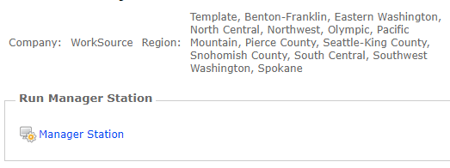
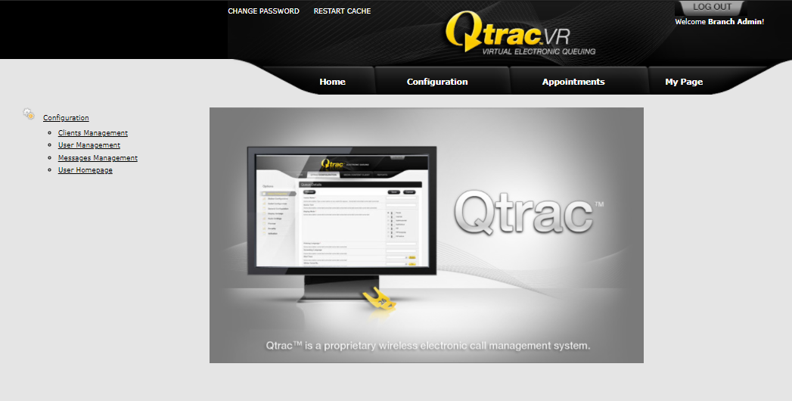
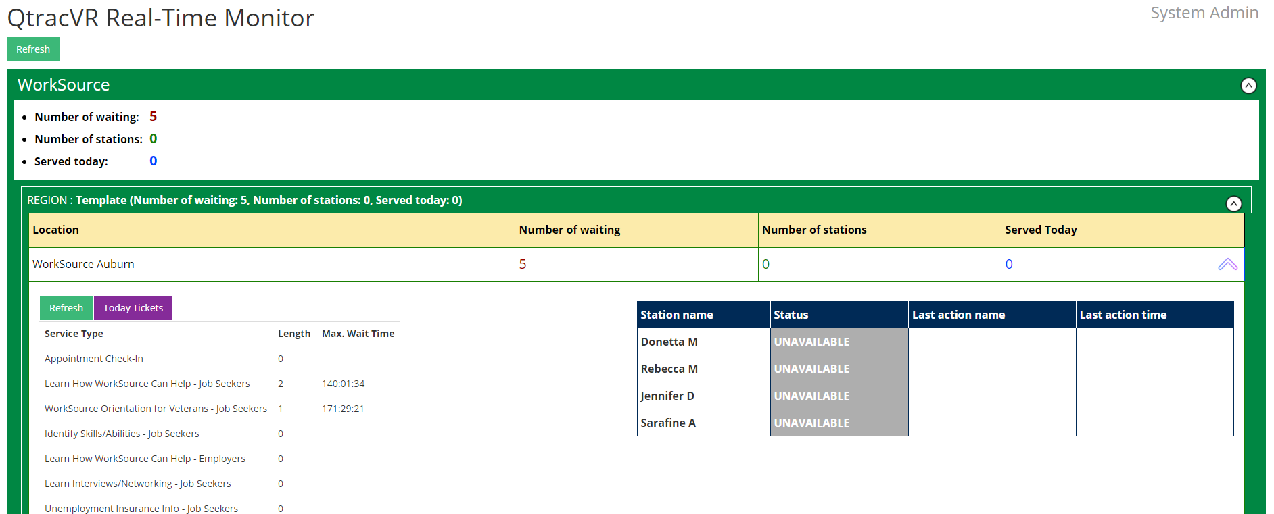
Manager Station
Log in to your account
Click on the “My Page” tab
Click on “Manager Station”
This tool is used to view Live Analytics during operating hours. Managers may see the current number of tickets waiting to be served (per office), number of tickets served today (per office), number of Stations open, last Station actions/activity, max wait time today per service, and other unique information.
2
1
3

Slide 4
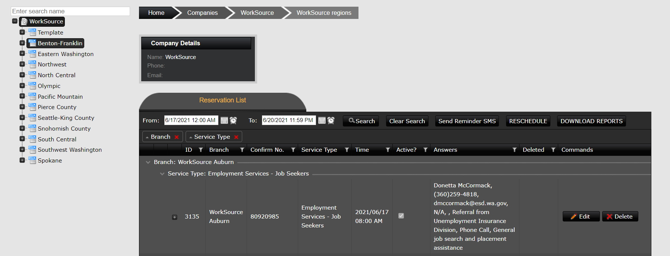
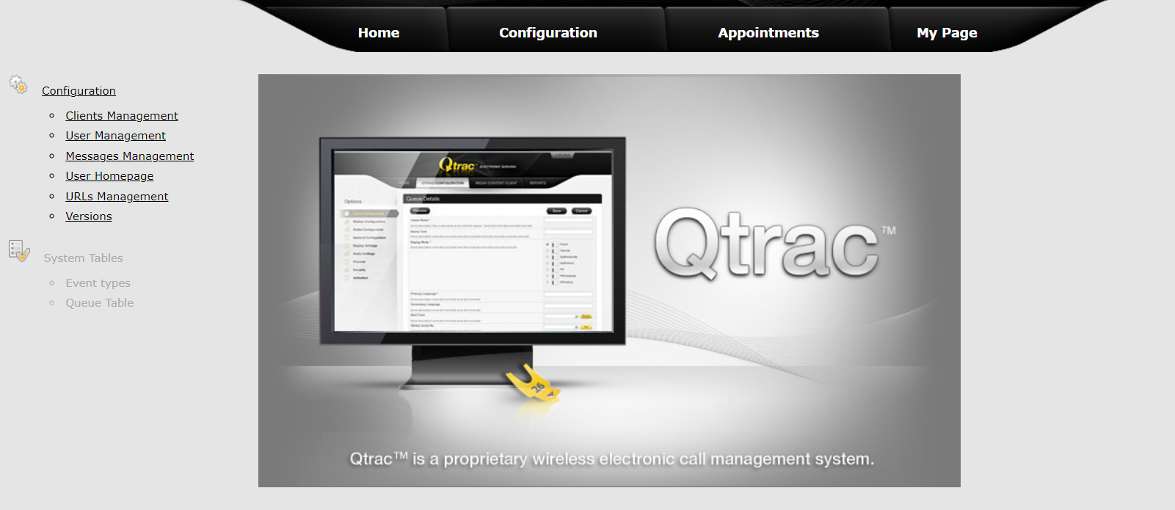
Live Appointment Analytics
To view a Report of past or upcoming appointments (in real time), please follow the below steps:
Note: If a Staff Member would like to view all appointments that they are assigned to, this report may be exported and provided to them. The report can be filtered in Excel to include only that Staff Member’s appointments.
Log in to your account
Click on the “Appointments” tab on the top of the page
Select a “From” and “To” time/date as your search window (click on the Calendar/Clock icons for dropdowns)
Click on the “Download Reports” button to export the Report to Excel
3
4
2
1

Slide 5
Operation Hours Management
The appointment scheduling calendar will be preset in the system according to office operation hours.
Please visit Workforce Professionals Center - Qtrac report issues (wa.gov) on how to submit requests to change operation hours settings in Qtrac.

Slide 6
Appointment Settings Management
Please visit Workforce Professionals Center - Qtrac report issues (wa.gov) on how to submit requests to change appointment settings in Qtrac.

Slide 7
User Management
After new staff are updated, added, or removed from Qtrac, Super User will need to manage their Stations.
Update, Add, or Remove Stations (Queue Management Dashboards)
Take the following steps to edit, add, or remove a station name:
Log in to your account
Click on the “Configuration” tab and head to your specific office (from the list on the left)
Click on the “Stations” tab
Click on the “Add New Station” button to add a new station, input the new name and press “Insert”
Click on the “Edit” button to edit the name of an existing station, edit the name and press “Update”
Click on the “Delete” button to remove a station, then click OK on the pop-up message

Slide 8
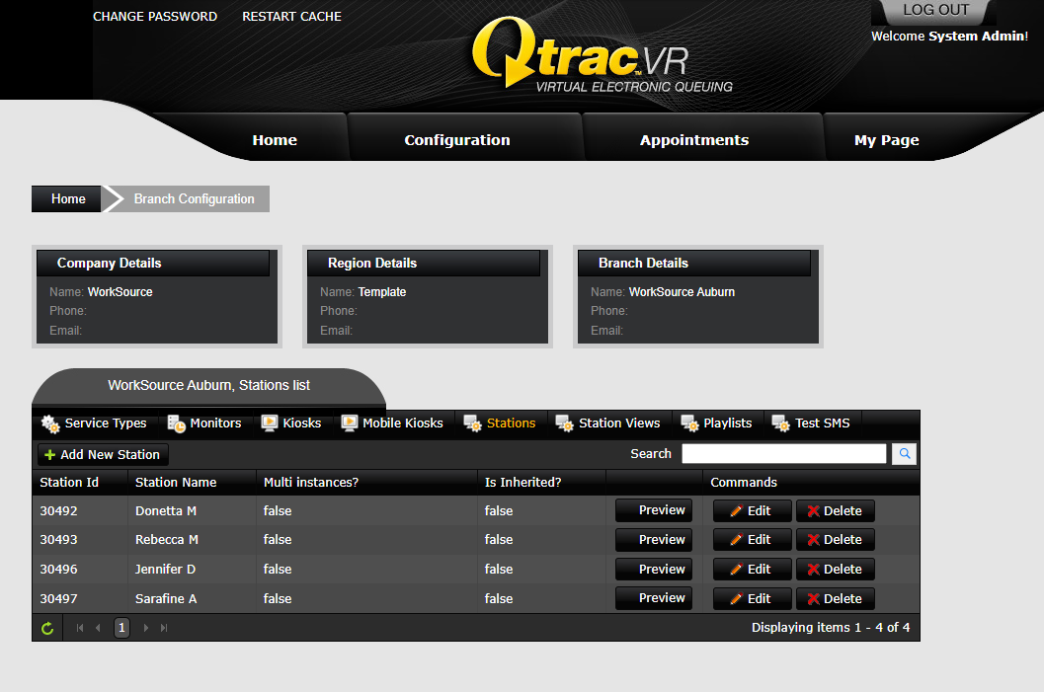
User Management
1
2
3
4
5
6

Slide 9
Reporting
Super Users may take the following steps to create new reports:
Log in to your account
Click on the “My Page” tab
Click on the “Manager Reports” link to access reports
You will be re-directed to the Qtrac Reports Server
Click on the “Show Report” button at the bottom to access saved reports
Click on the “Add new report” button at the bottom to create new reports
Click on the “Create a new view button” button
Click on the “Add” button
You will see many fields on the left. Drag them into the below sections to create a customized view (you will want to add a “Filter” to filter by fields such as Creation Date, then drag the fields you will want to see in the Report to the “Rows” section. You can add calculated fields by dragging a field to the “Values” section.). You may also click on a field once it is in the below sections to edit the name of the field or change its calculation (sum, average, count, etc.).
Once complete, Click on the “Build” button (You can select View options to change the reporting view as well)
Once the report is built, enter the filter values such as Creation date or Office Name and click the “Refresh” button
To download the report, click on any of the “CSV / Excel / PDF” buttons. You can also Copy or Print the report.
To save this customized report, click on the “ ”(Save Icon) in the top-left corner and name the Report.
Step-by-step images follow on the next few slides.

Slide 10
Reporting
1
2
3

Slide 11
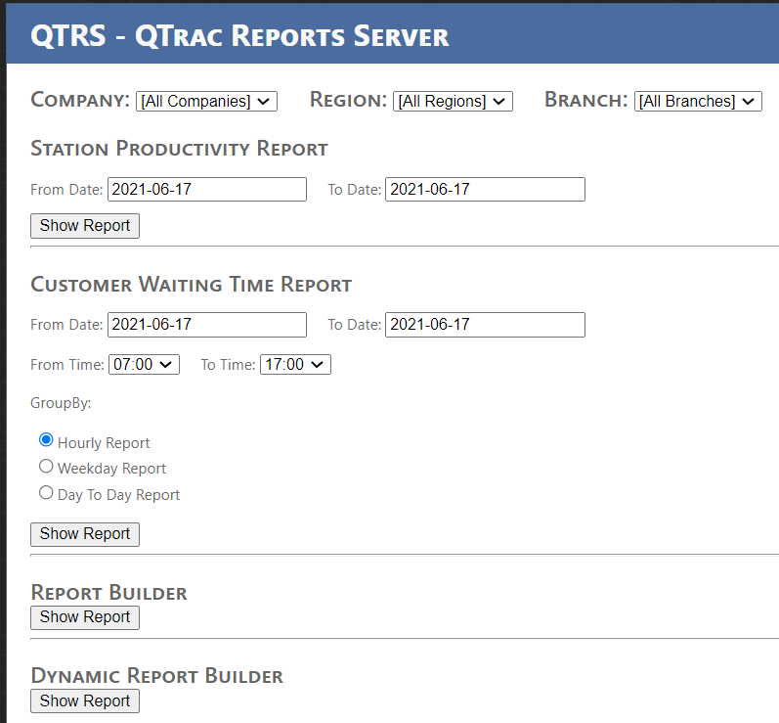
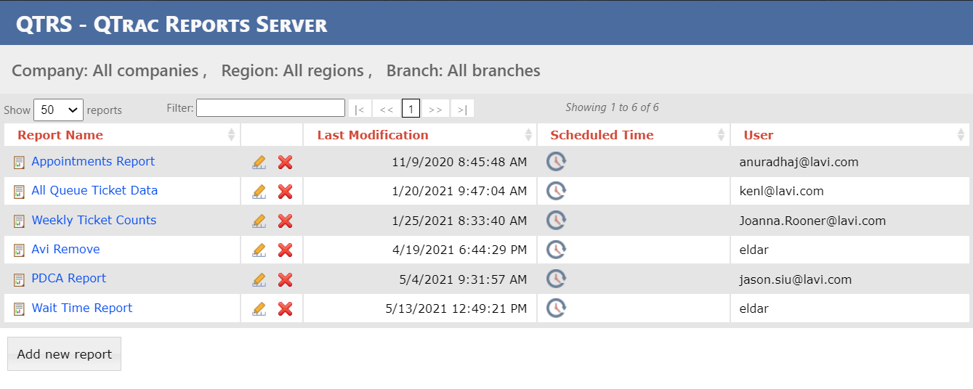
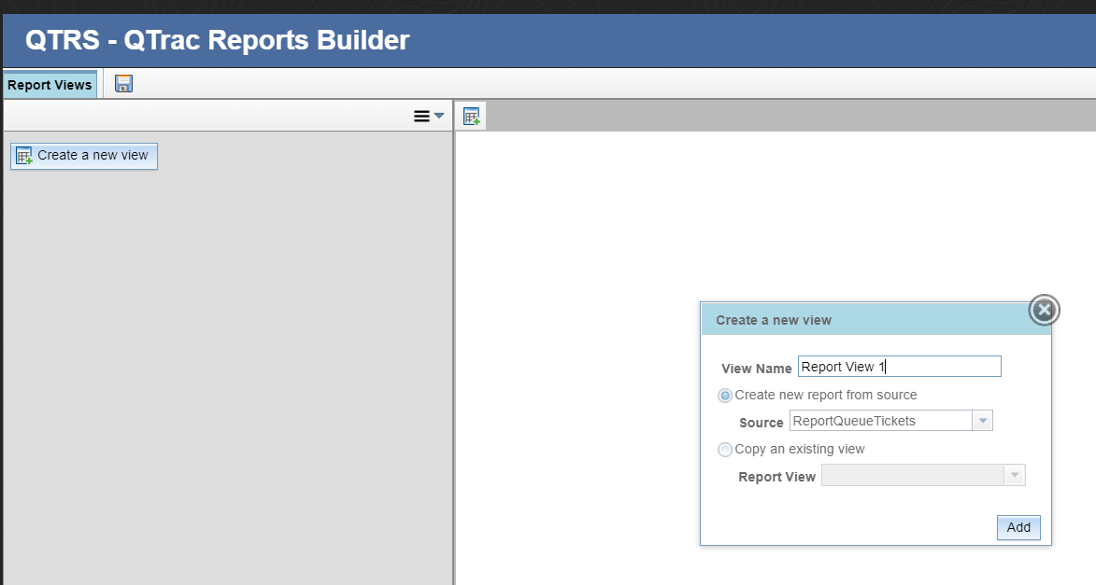
Reporting
4
6
7
5
8

Slide 12
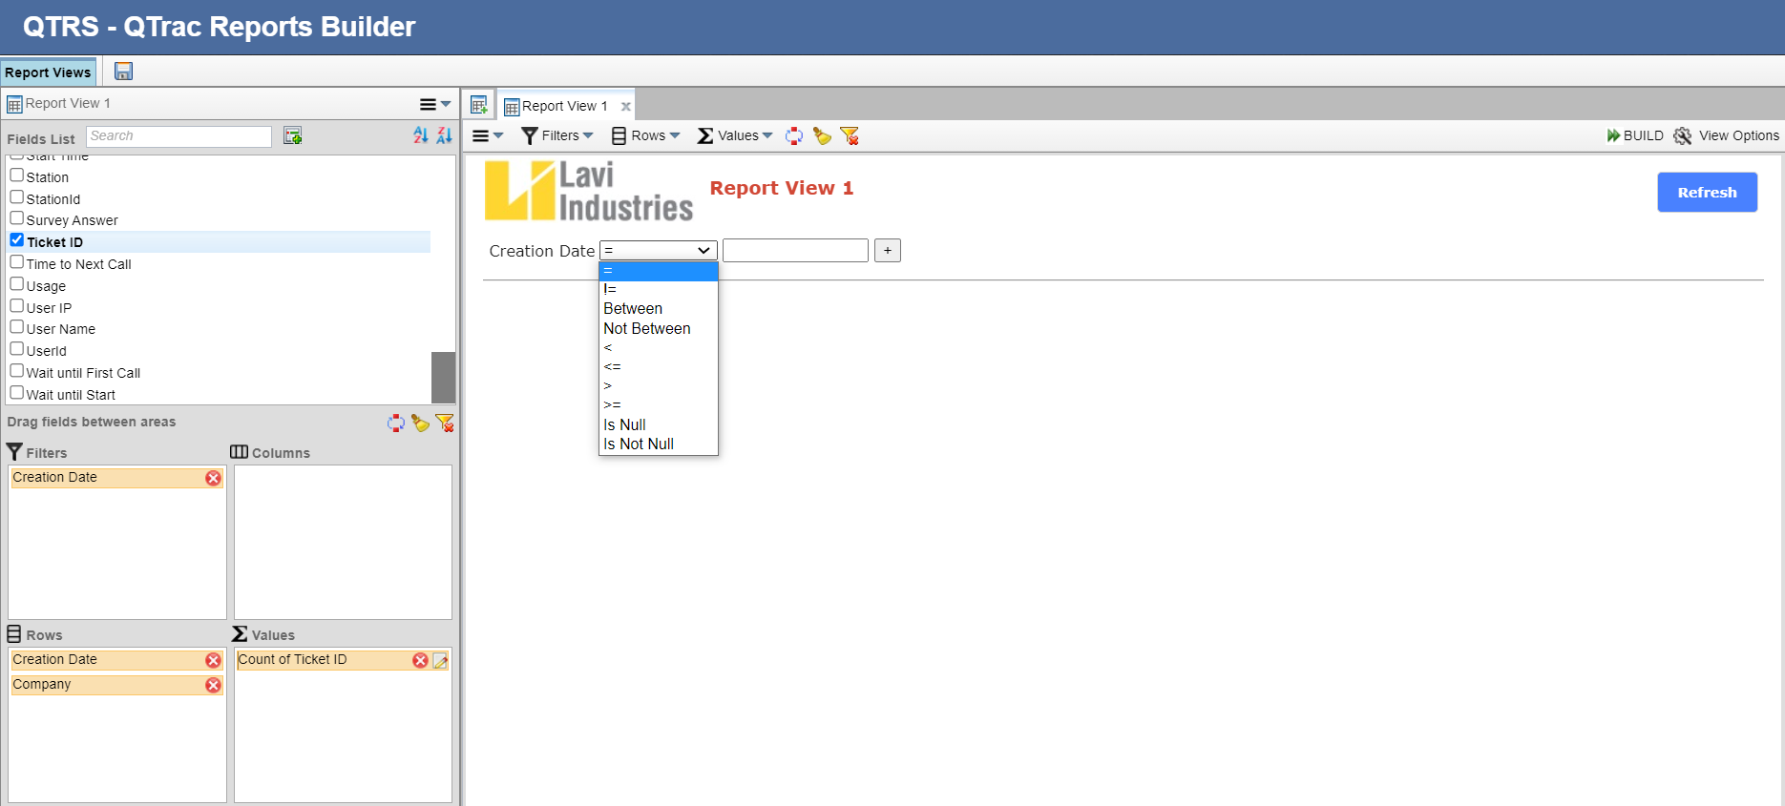
Reporting
13
10
9
11
Note: You may choose a value for the filter once the Report is built. For instance, Creation Date “=“ X, or Creation Date “Between” X and Y.
12

Slide 13
Reporting
Super Users may also take the following steps to access saved reports:
Log in to your account
Click on the “My Page” tab
Click on the “Manager Reports” link to access reports
You will be re-directed to the Qtrac Report Server
Click on the “Show Report” button at the bottom to access saved reports (all Saved Reports will show here, they will appear here after pressing the “Save” button on a new Report)
To access a saved report, click on specific Report Name. To edit the Report, you may click on the “pencil” icon. To delete the Report, click on the “X” icon.
Filter the Report (by Creation Date, Office Name, etc.)
Click on the “Refresh” button
To download the report, click on any of the “CSV / Excel / PDF” buttons. You can also Copy or Print the report.
Step-by-step images follow on the next few slides.
Note: Data is copied to the Reports Server nightly. Meaning, the Reports Server will not have today’s data until tomorrow. This works the same way with permissions as well. If permissions to reports are given to user, it will not take effect until the following day.

Slide 14
Reporting
1
2
3

Slide 15
Reporting
4
6
7
8
9
5

Slide 16
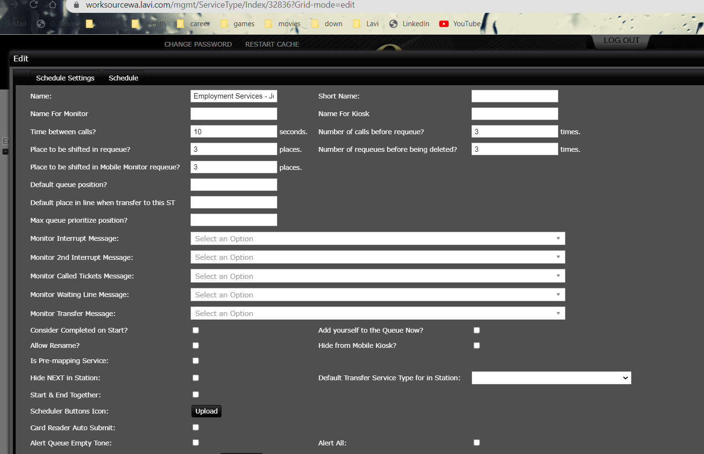
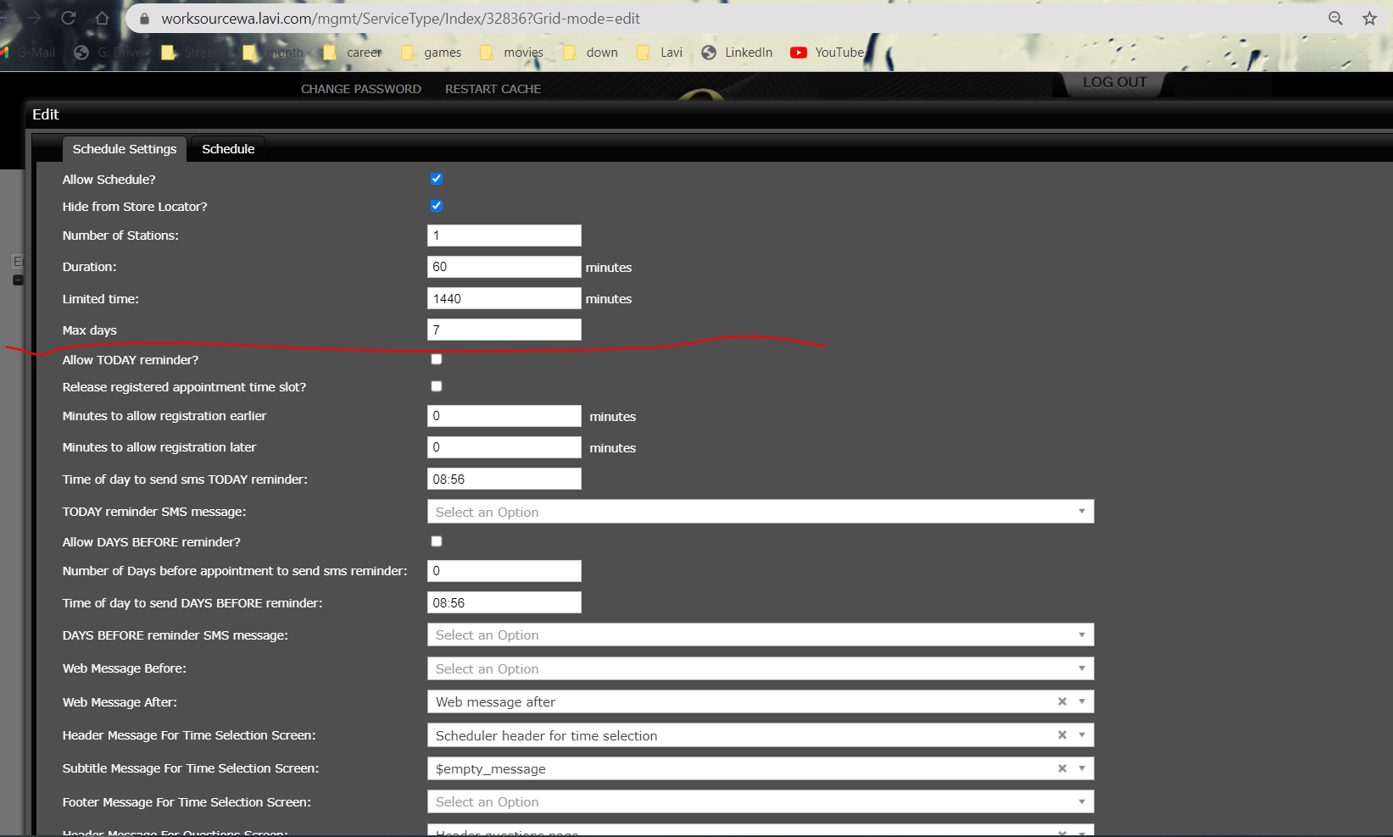
Super Users – DO NOT TOUCH
Please do not touch the following configuration elements in the system.
#1: When editing a Service Grouping, DO NOT TOUCH ANY SETTINGS on the initial “default” Appointment Settings page.
#2: When selecting the “Schedule Settings” tab for additional Appointment Settings, DO NOT TOUCH ANY SETTINGS under the red line in the screenshot below.

Slide 17
Live Demonstration
SCENARIOS:
Manager Station / Live Analytics
Operation Hours Management
Appointment Settings Management
Reporting Capabilities

Slide 18
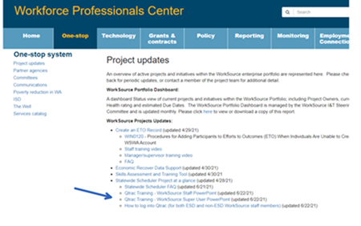
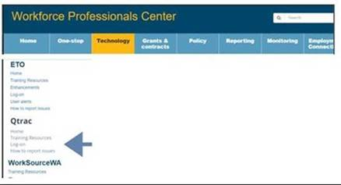
Support Plan
The https://WPC.wa.gov/tech tab on WPC will have a section for Qtrac information on:
Training Resources – WS Staff and Super User training material – how-to’s, training videos, FAQ
Log-on – The link WS staff to use to logon to the Qtrac system
How to report issues – incidents, issues reporting and who staff should contact for help with the system
How to request access – how to request new users to be added to the system
The site is under development and would be evolving, and the base information should be available for launch.

