Slide 1
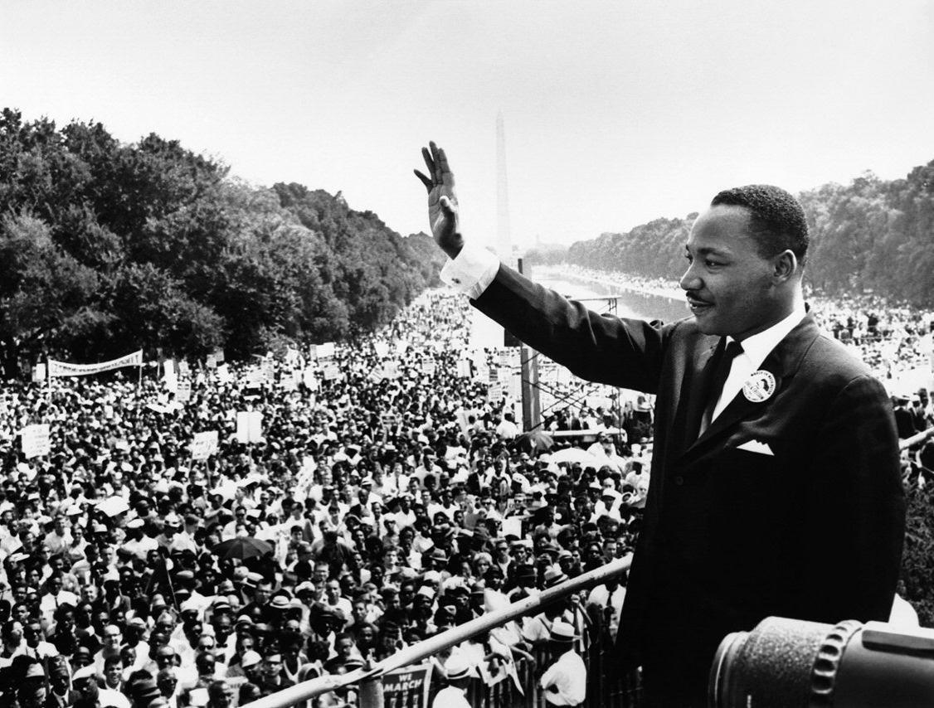
Martin Luther King Jr. Day
WorkSource Xxxxxxx will be closed Monday, Jan. 15, in observance of Martin Luther King Jr. Day

