Slide 1
BRAND 101
The basics of branding.
Notes:
Notes:
Personalize your intro and T-up this presentation with a few general words about what you want your audience to walk away with.

Slide 2
?
What is BRAND?
Is it THIS?
Notes:
Notes:
What is our “Brand”? Is it this? (Point to the logo)?
[Click to next slide]

Slide 3
n
o
Our logo is not our BRAND
It’s our IDENTITY
Notes:
Notes:
What is our “Brand”? Is it this? (Point to the logo)?
[Click to next slide]

Slide 4
Our BRAND is
our REPUTATION
Notes:
Notes:
Simply put, our “brand” is our reputation. It’s our credibility in the market space we occupy.
[Click to next slide]
4

Slide 5
BRANDS are not defined by marketers or designers. They are defined by INDIVIDUALS.
Brand is a gut feeling because people are emotional intuitive beings.
Notes:
Notes:
Brand is a person’s GUT feeling about an organization, it’s products and/or services.
And that gut feeling is reality… because as you know perception is reality
[Click to next slide]

Slide 6
In other words…
It’s not what WE say it is.
Notes:
Notes: (Read slide)… pause for effect…
[Click to next slide]
6

Slide 7
It’s what THEY say it is.
USERS & CONSUMERS
Notes:
Notes:
Point to people on screen and say “It’s what THEY say it is.”
Brand is important because people will share both their negative and positive experiences, but desire to repeat only the positive ones.
The idea is to make everyone a “Brand Ambassador” for WorkSource, by influencing their perception. But how?
Hand off to Brian
[Click to next slide]
7

Slide 8
BRAND is also not BRANDING
Notes:
Notes:
Before I get to the meat of this presentation (basecamp) I wanted to talk about branding. We talked about brand, but what is branding?
[Click to next slide]

Slide 9
BRANDING is a verb
It’s the PUSH behind the brand
IT’S APPLIED FORCE
Notes:
Notes:
Branding is a verb. Branding is simply the driving force behind the brand. It’s all the things that go into promoting our services and creating a positive experience worth repeating.
[Click to next slide]
9

Slide 10
Branding is ALL of the ways you establish an image of your company in the consumers mind. It’s the marketing practice of shaping how and what PEOPLE’S PERCEPTIONS of your business are.
Notes:
Notes:
It is all the individual components that when working together, generate awareness and drive the brand. (It’s the fuel).
Often times these individual components are confused as “the brand”.
[Click to next slide]
10

Slide 11
What makes a POWERFUL BRAND?
Notes:
Notes:
Read slide… “So, what makes a powerful brand”
Maybe it’s the yummiest thing anyone has ever tasted?
Or, perhaps it just works better than all the rest?
No, it’s the cool logo, clever slogan and catchy jingle right?
No doubt, these are all play a part in “branding” but these are not what make a brand powerful…
[Click to next slide]

Slide 12
It has to MATTER!
Notes:
Notes:
(Point to screen)… This is what makes a brand powerful!
It has to matter and people need to know why it matters.
[Click to next slide]

Slide 13
Notes:
Notes:
Here is one example of a brand that matters and why it’s trusted over other brands..
Any guesses on their brand promise?
[Click to next slide]

Slide 14
Search the world’s information –
Find exactly what your looking for.
Notes:
Notes:
“Search the world’s information –
Find exactly what you’re looking for.”
Google’s reputation, far and away, is that it’s the “Best” search engine. because of this next slide…
[Click to next slide]

Slide 15
Notes:
Notes:
Take a moment to let this sink it…
Does accuracy matter? Yes, accuracy matters. Google knows this and delivers it far more often than not! That’s powerful!
(By the way, I just gave you a reason why you should use Google for search, which officially makes me a brand ambassador for Google).
[Click to next slide]

Slide 16
WHY WorkSource?
Notes:
Notes:
This is our filter as we do our work and share our story with the world. WorkSource has to matter and Businesses and Job Seekers need to know why it matters.
[Click to next slide]

Slide 17
The focus test
Who are we?
What do we do?
Why does it matter?
Notes:
Notes:
This is our filter as we do our work and share our story with the world. WorkSource has to matter and Businesses and Job Seekers need to know why it matters.
When we create branded promotional pieces, we should insure that it clearly states the following:
Who are we…
Quickly introduce ourselves?
What do we do…
Concisely and accurately share only the information needed to make smart decisions.
Why it matters to them…
What is compelling about the services we provide. How do WorkSource business services benefit them, where can we take them, that they have not already been?
[Click to next slide]

Slide 18
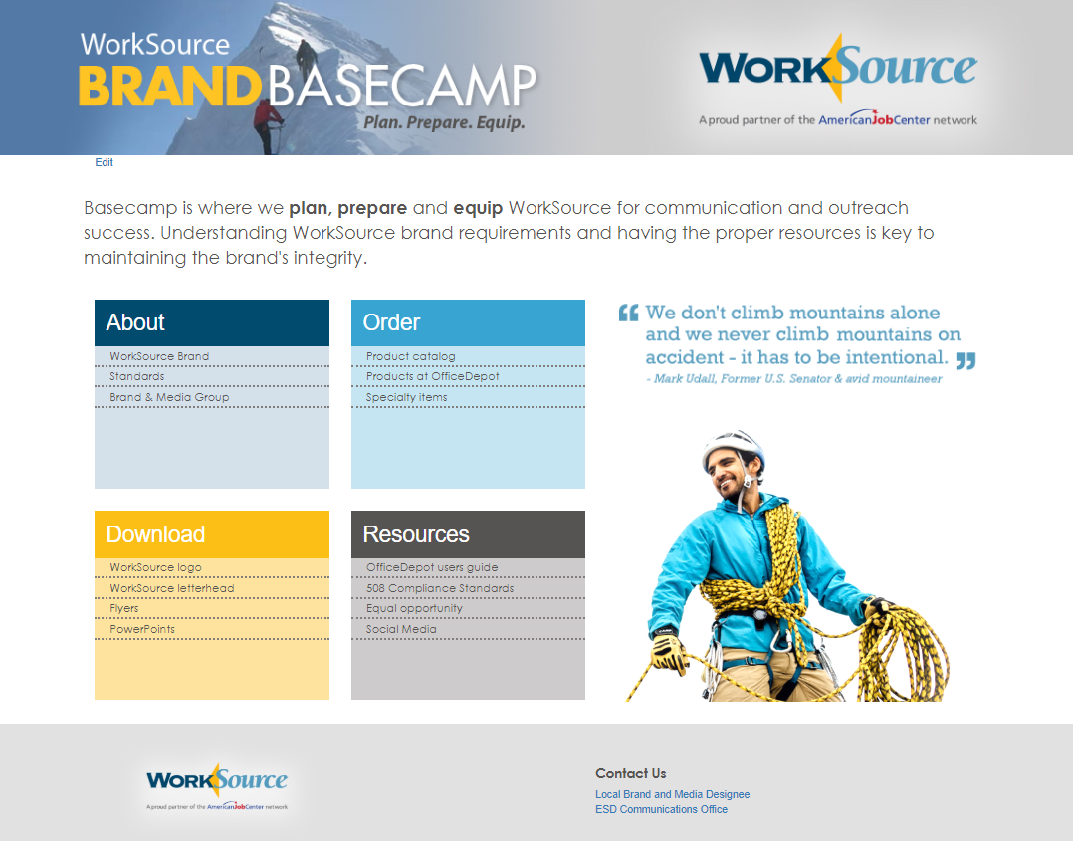
Notes:
Notes:
Just as in mountaineering, a “basecamp” is where we come back to REFUEL, REGROUP & RETOUL. It’s where we Plan. Prepare & Equip:
Know what resources are available and where to get them.
Understand the brand and think through the processes of promoting it. What do we need to get where we are going, what will we need when we get there?
(I will walk them though each section briefly).
18

Slide 19
THANK YOU FOR BEING A BRAND AMBASADOR
Notes:
Notes:
Conclusion –
The summit requires an intentional effort. It does not happen by accident. In fact accidents happen when we don’t effectively plan, prepare and equip appropriately.
There is safety in numbers:
Accountability insures that we are and understand the plan. Having more than one set of eyes and one perspective gives us a better chance at success.
[Click to next slide]
19

Slide 20
QUESTIONS?
WorkSource is an equal opportunity employer/program. Auxiliary aids and services are available upon request to individuals with disabilities. Washington Relay Service: 711
Notes:
Notes:
Question and Answer
[Click to next slide]

