Slide 1
Layoff Information Session: Getting Back to Work
WorkSource is an equal opportunity employer/program. Auxiliary aids and services are available upon request to individuals with disabilities. Washington Relay Service: 711
8/1/2023

Slide 2
Welcome
This is an interactive presentation. We are here to share valuable information and to answer any questions you may have. Please feel free to utilize the two methods below:
During and/or after the presentation, please direct questions to the Q&A box. Refer to the panelist by name or subject if possible. Please do not direct questions to the host.
Use the “Raise Hand” feature. Please remember to put your hand down after your question has been answered.
Notes:
Optional slide

Slide 3
Agenda
WorkSource
Unemployment Insurance Benefits
Health Insurance
WIOA Title 1 Dislocated Worker Program
Community and Technical College Worker Retraining Programs

Slide 4
BEING LAID OFF IS PAINFUL.
It can be hard to pick up the pieces and look for a new job. Today, we would like to introduce you to WorkSource and the various programs and services in place to help you get back to work as quickly as possible.
Notes:
Optional slide

Slide 5
What is WorkSource?
WorkSource is a federally funded partnership of state and local organizations that provide employment and training solutions at no cost.
A “one-stop” center providing free access to computers, copiers, phone, fax, and Wi-Fi.
Find a local WorkSource office online.
Washington State Unemployment Insurance Department is part of WorkSource.

Slide 6
Unemployment Insurance Benefits
Temporary financial assistance funded by employer taxes.
Benefits are designed to help workers who are unemployed through no fault of their own. Benefits are not meant to replace your earnings, but they can help you meet expenses until you return to work.
Benefits are not based on financial need.
You will need to file an initial claim to establish eligibility.
Benefits are considered taxable income.

Slide 7
Unemployment Insurance Benefits
Funded by employer taxes and limited in duration.
Benefits are limited in duration and require three documented job searches per week. Record and keep your job search log.
If your claim is denied, you have the right to appeal.
You need to submit a weekly claim for each week you wish to receive benefits.

Slide 8
Unemployment Insurance Eligibility
Eligibility is based on employment history and the reason you are no longer working.
Eligibility includes:
680 hours of employment
Wages in Washington State or with a combination of other states
Unemployed through no fault of your own
Being able and available for full time work
For more information, go online.

Slide 9
Application process
The fastest way to apply is online. You can file by phone, but you might experience long wait times.
If you don’t already have one, create your Secure Access Washington (SAW) account.
Go online to see what information you will need to apply.

Slide 10
How to apply by phone
You can also file by phone. There are no in-person unemployment offices in Washington State.
Call 1-800-318-6022 between the hours of 8 a.m. to 4 p.m., Monday-Friday. Wait times may be long.

Slide 11
When to file the initial application
Notes:
Optional slide

Slide 12
File weekly for benefits
File each week (Sunday to Saturday).
If submitting online, file anytime between 12:01 a.m. on Sunday, and 11:59 p.m. Saturday of that same week.
If submitting by phone (1-800-318-6022), file anytime between 12:01 a.m. on Sunday, and 4:00 p.m. on Friday (unless Friday is a holiday).
If you work or are paid sick/vacation leave, report hours and earnings.
If you are eligible, benefits are normally received 2-3 days after claiming for the week.

Slide 13
When to file weekly claims
Notes:
Optional slide

Slide 14
Payment of benefits
Benefits are paid via direct deposit or VISA debit card.
If you apply online, you can choose direct deposit or VISA debit card issued by U.S. Bank.
If you apply by phone, you will automatically receive a VISA debit card issued by U.S. Bank in 7-10 days.
Funds will be deposited electronically and paid out weekly.

Slide 15
What income is reportable?
When being laid off, you need to report:
Severance pay received over a certain number of weeks. Answer the severance question “yes.” Additional questions will be asked.
A lump sum severance package is reportable but may not be deductible. Additional questions will be asked to determine if the pay is deductible or not.
Payment for vacation, sick, PTO, or holiday pay connected to the week(s) you are claiming. (If your vacation/sick/PTO is a cash-out, it is not reportable.)
A bonus, if connected to the week(s) claimed.
You must report any wages and hours worked when filing weekly.

Slide 16
How long is my unemployment claim?
Your claim will be effective on a Sunday and expire one year from that date.
Typically, an individual has up to 26 weeks of benefits.
Your claim will be effective on a Sunday and will expire one year from that date. You have 26 weeks of benefits from the effective date of your claim.
You do not have to use the weeks of benefits consecutively.
You can stop claiming at any time, and you can restart at any time before the claim expires.

Slide 17
Job search is required!
While receiving unemployment benefits, you must search for work and keep a job search log.
Benefits are limited in duration and require three documented job searches per week.
You are required to maintain a record of your activities each week. Download a job search log or make your own list. A Claims Specialist may ask you to provide this information. Keep this log for 30 days after your claim has ended.

Slide 18
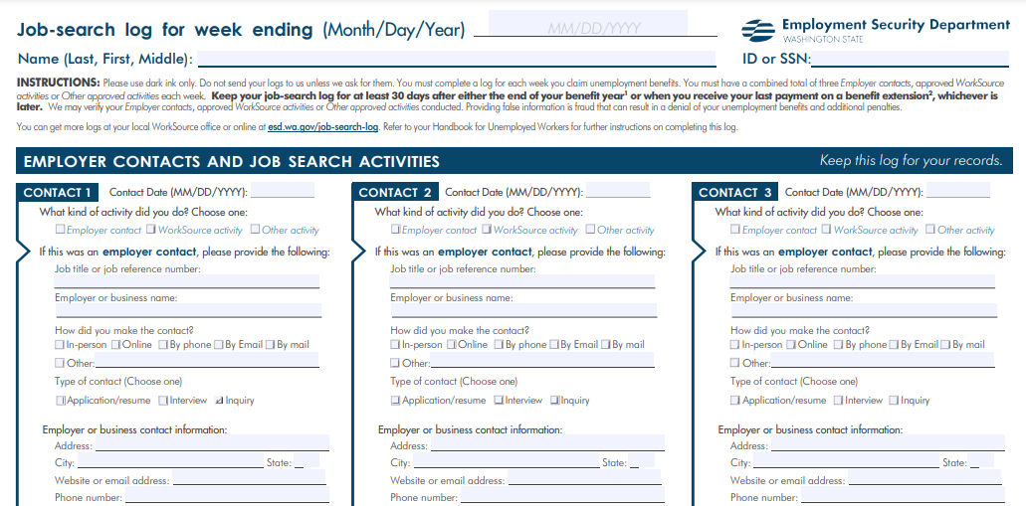
Job search log

Slide 19
Additional assistance
There is helpful information on the Washington Employment Security Department website:
Tips to avoid delays: https://esd.wa.gov/unemployment/tips
Submitting a weekly claim: https://esd.wa.gov/unemployment/weekly-claim-questions
eServices: https://esd.wa.gov/unemployment/technical-support
All information can be found at: https://esd.wa.gov

Slide 20
Health insurance
You have 60 days to choose an option:
COBRA allows you and your immediate family to stay on an employer-sponsored health plan under certain circumstances; however, coverage can be expensive. Visit https://www.dol.gov/general/topic/health-plans/cobra
The Health Benefit Exchange offers access to affordable insurance plans for all and your lay-off is a “life change” that qualifies you for out-of-cycle enrollment. Visit https://www.wahealthplanfinder.org/
Medicare is available for people 65 or older, or those under 65 on Social Security Disability Income, or diagnosed with certain diseases. Call SHIBA at 800-562-6900.

Slide 21
Health insurance
For more help:
Visit: www.insurance.wa.gov/cant-afford-coverage

Slide 22
A “Dislocated Worker”
The Workforce Innovation and Opportunity Act offers a program that helps people who have lost work through no fault of their own. Like you, they are “dislocated.”
Must be eligible to collect unemployment insurance benefits.
18 years or older
Legal to work in the U.S.A.
Registered with Selective Service (males only)
One-on-one assistance, training, education, and supportive services.

Slide 23
Worker retraining
The Worker Retraining Program provides educational funding for laid off and dislocated workers who may want to upgrade their skills or start a new career.
Funding is available through all community and technical colleges; it may include tuition, books, and fees for up to three quarters. Short and long-term training options are available.
Certificates and Associate’s Degree (two-year program)
Assistance with navigating resources, partners, and the financial aid process.
One-on-one career counseling.

Slide 24
Commissioner Approved Training (CAT)
Commissioner Approved Training allows you to collect regular unemployment benefits while attending an approved, full-time training program.
If approved for CAT, you do not have to look for work while going to school.
CAT does not pay for books, tuition or other school related fees.
You must apply for CAT. The application is complex. Visit a WorkSource office for assistance.
Do not enroll in school before being approved for CAT.
Notes:
Optional slide

Slide 25
What is Trade Adjustment Assistance?
If foreign competition was a contributing factor in your layoff, you may be eligible for Trade Adjustment Assistance (TAA)
TAA is a federal program that provides aid (training, job search and relocation allowances, income support, and more) to workers who lose their jobs or whose hours and wages are reduced as a result of increased imports or shifts in production outside the United States. A TAA petition may be filed by a group of three or more employees or by the Washington State Labor Council.
Notes:
Optional slide. TAA is not currently funded.

Slide 26
WSLC
Washington State Labor Council (WSLC) advocates for union and non-union workers. If you need additional help, please contact their staff.
Chelsea Mason-Placek Emmanuel Flores
Cell 253.973.3324 Cell 360.561.4657
cmasonplacek@wslc.org eflores@wslc.org
Notes:
Optional slide

Slide 27
Local Rapid Response contacts:
If you need additional help, please contact:
First & Last Name First & Last Name
Phone 000.000.0000 Phone 000.000.0000
email@ email@

Slide 28
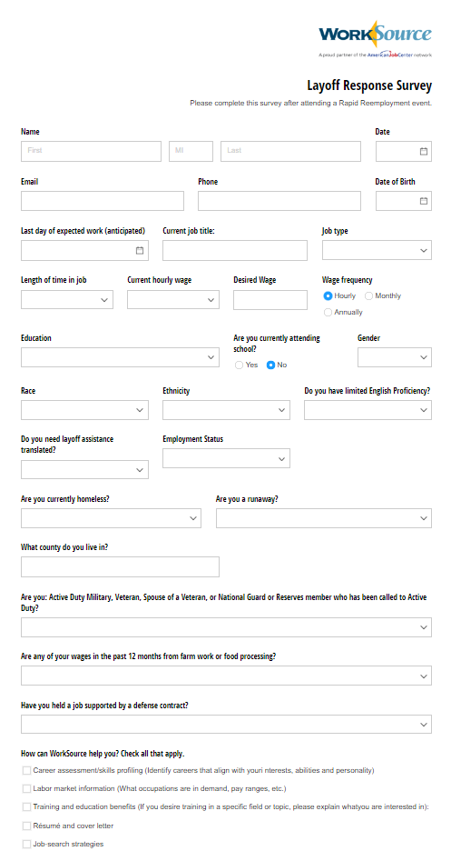
Survey
If you have not completed the survey already, please do so now.
Local Link or QR Code
Notes:
Optional slide

Slide 29
Wrap up
Read and absorb information shared with you today.
Set up your WorksourceWa.com account and upload your resume.
Apply for Unemployment Benefits upon layoff; many resources not available if you have not applied.
Contact WorkSource to connect with a WIOA Counselor for one-on-one help.
Visit esd.wa.gov. Download and use the Job Search Logs.
Consider training or certification.
Look for workshops, hiring events, and job fairs on WorkSourceWa.com.
Check with Department of Labor regarding your health insurance and/or retirement plan.
Reach out to the Washington State Labor Council for additional support.
Remember, you now have a network! Reach out to us for support.
Notes:
Optional slide

